Slide 1
1. An object A is an enlargement of object B such that
volume of object A : volume of object B = 27 : 1 728
What would be the following ratio be:
a) length measured on A : length measure on B
b) surface area of A : surface area of B
2. Coffee is sold in regular and large cups. The two cup are mathematically similar in shape. The large cup is 21 cm high and holds 540 mL. The regular cup is 14 cm high. Calculate the volume of the regular cup.
3. Two similar pyramids have volumes of 64cm³ and 343cm³. What is the ratio of their surface areas?
4. These two shapes are similar. What is the length of x?

Slide 2
Similarity
Lesson 2

Slide 3
Similarity
Notes:
http://www.outpost-art.org/images/Leonardo%20Da%20Vinci/Mona%20Lisa.jpg
http://www.holytaco.com/25-shopped-mona-lisa-portraits/

Slide 4
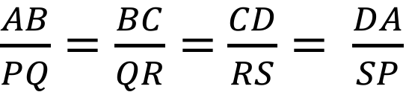
Similarity
In similar figures:
All pairs of matching sides are in the same ratio; and
All pairs of matching angles are equal.
A
B
P
Q
S
R
D
C
$\frac{AB}{PQ}=\frac{BC}{QR}=$ $\frac{CD}{RS}= \frac{DA}{SP}$
Notes:
http://www.outpost-art.org/images/Leonardo%20Da%20Vinci/Mona%20Lisa.jpg
https://www.mathsisfun.com/geometry/triangles-similar.html

Slide 5
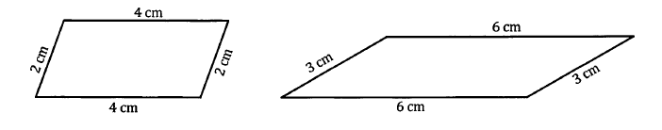
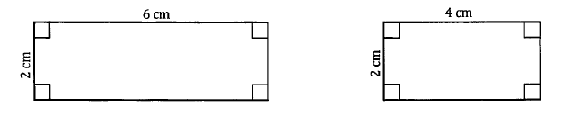
Notes:
http://handsonmath.blogspot.com.au/2012/10/congruent-vs-similar-shapes-while.html

Slide 6
Notes:
http://www.bbc.co.uk/schools/gcsebitesize/maths/geometry/congruencysimilarityrev1.shtml

Slide 7
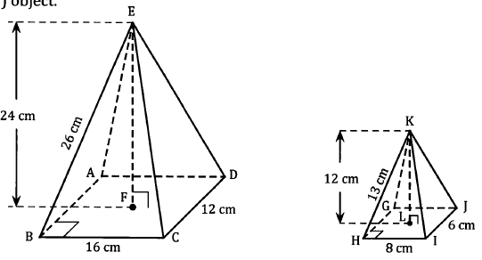

Slide 8
wxyz and WXYZ are similar figures.
What is the length of XY?
What is the size of angle wxy ?

